Slide 1


Team 30: Smart Pest Repeller
Bi-Weekly Update 1 Michael McNeil
Andrew Albritton
Melquisedec Ordonez Sponsor: Peng-Hao Huang
Notes:
Michelle

Slide 2
Project Summary
Pest control methods will often make the customer choose between options that are environmentally unfriendly or ineffective. Pesticides that are commonly used in pest control often can be dangerous for the plant life or pets that may be exposed to them and other alternatives such as ultrasonic plug ins are not as effective due to their use of limited frequencies. The goal of the Smart Pest Repeller system is to provide an effective form of pest control that is also safe for people and animals to be around. The system ensures this by using a machine learning program to identify a pest and respond with the appropriate ultrasonic sound response to deter pests in the target area.
Notes:
Kyle

Slide 3
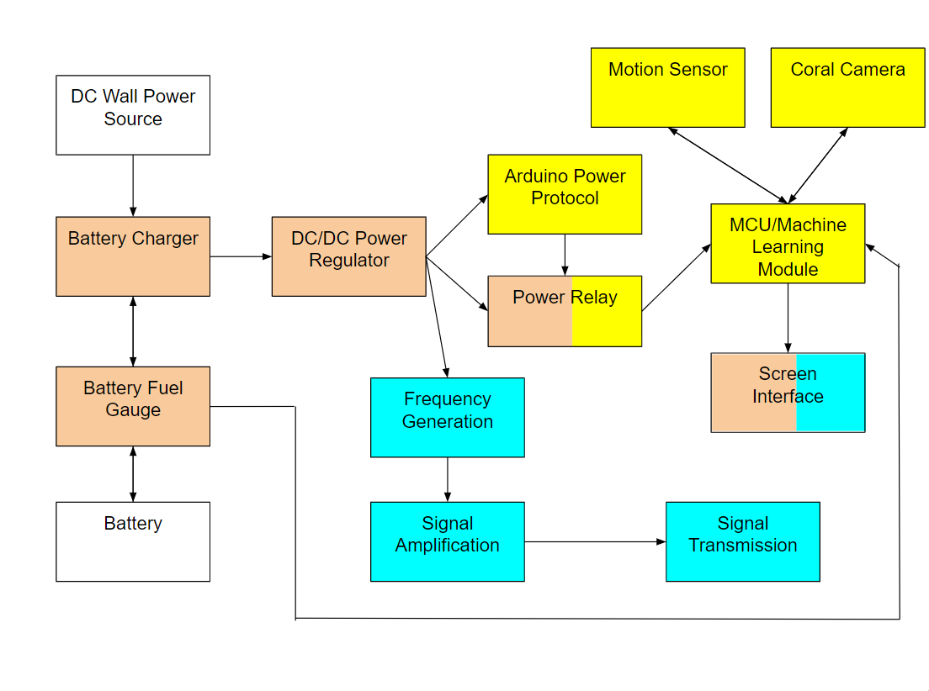
Project/Subsystem Overview
Notes:
Eric

Slide 4
Major Project Changes for 404
Power System PCB redesign currently underway. Addressing any design issues discovered during 403.
Emitter Redesign required as subsystem was not operating correctly during demo.
Notes:
Eric

Slide 5
Project Timeline
Power
Redesign of PCB finished and assembled by 2/29
MCU
Finish subsystem validation by 2/28
Begin preparing code for integration with emitter subsystem by 3/8
Emitter
Subsystem redesign to be completed by 2/19
ALL
Finish MCU integration with Emitter subsystem by 3/15
Finish MCU integration with power subsystem by 3/8
Finish system Chassis by 3/20
Finish full system validation by 4/18
Notes:
Eric

Slide 6
Power Subsystem
Michael McNeil
Accomplishments since 403 20 hrs of effort | Ongoing progress/problems and plans until the next presentation
Schematic Redesign for Power PCB Part Order for Redesign | PCB Layout Redesign

Slide 7
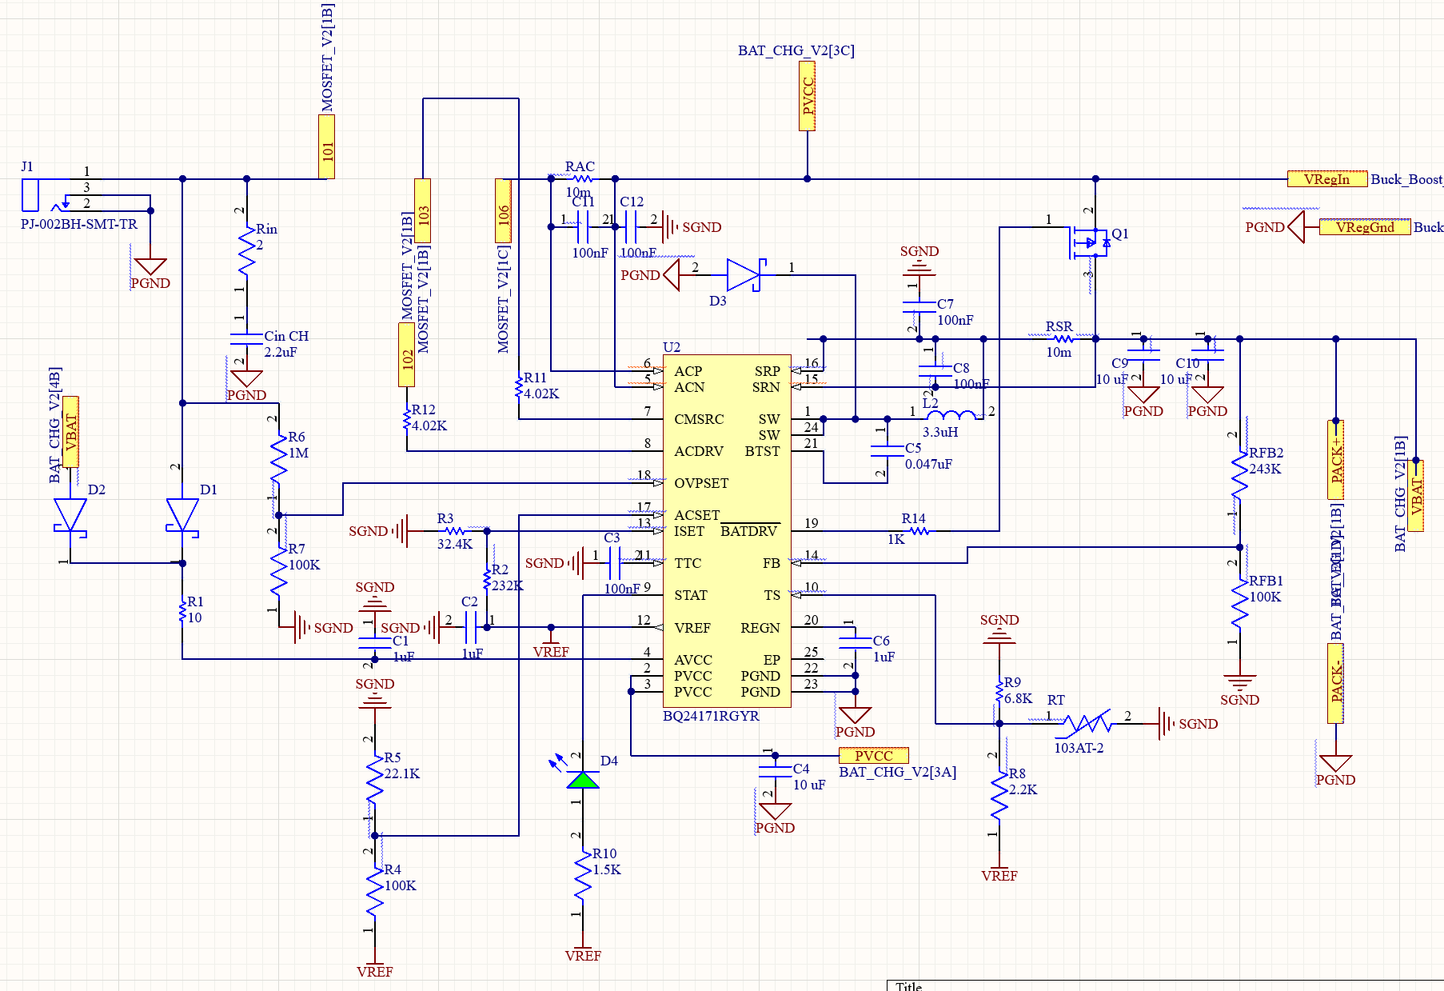
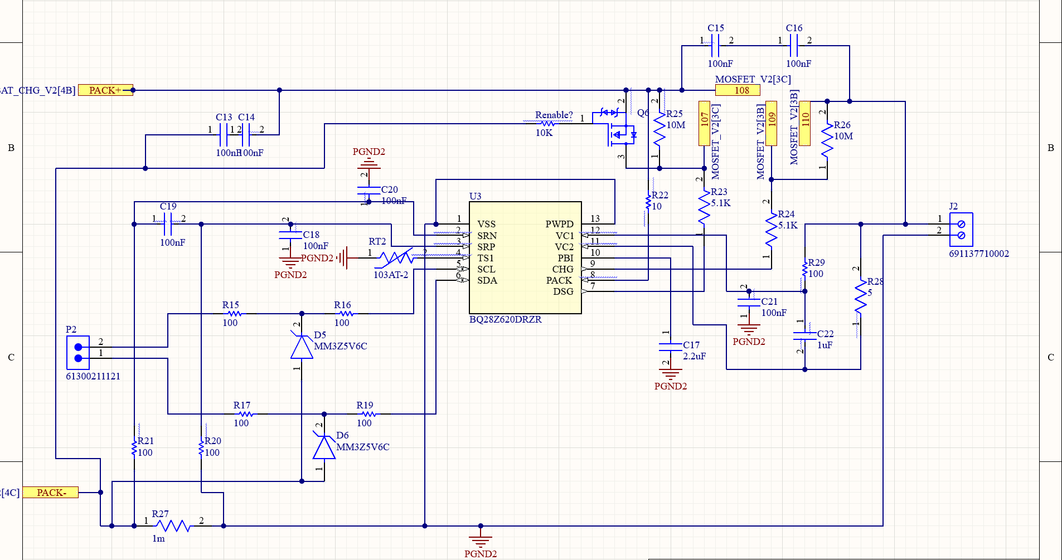
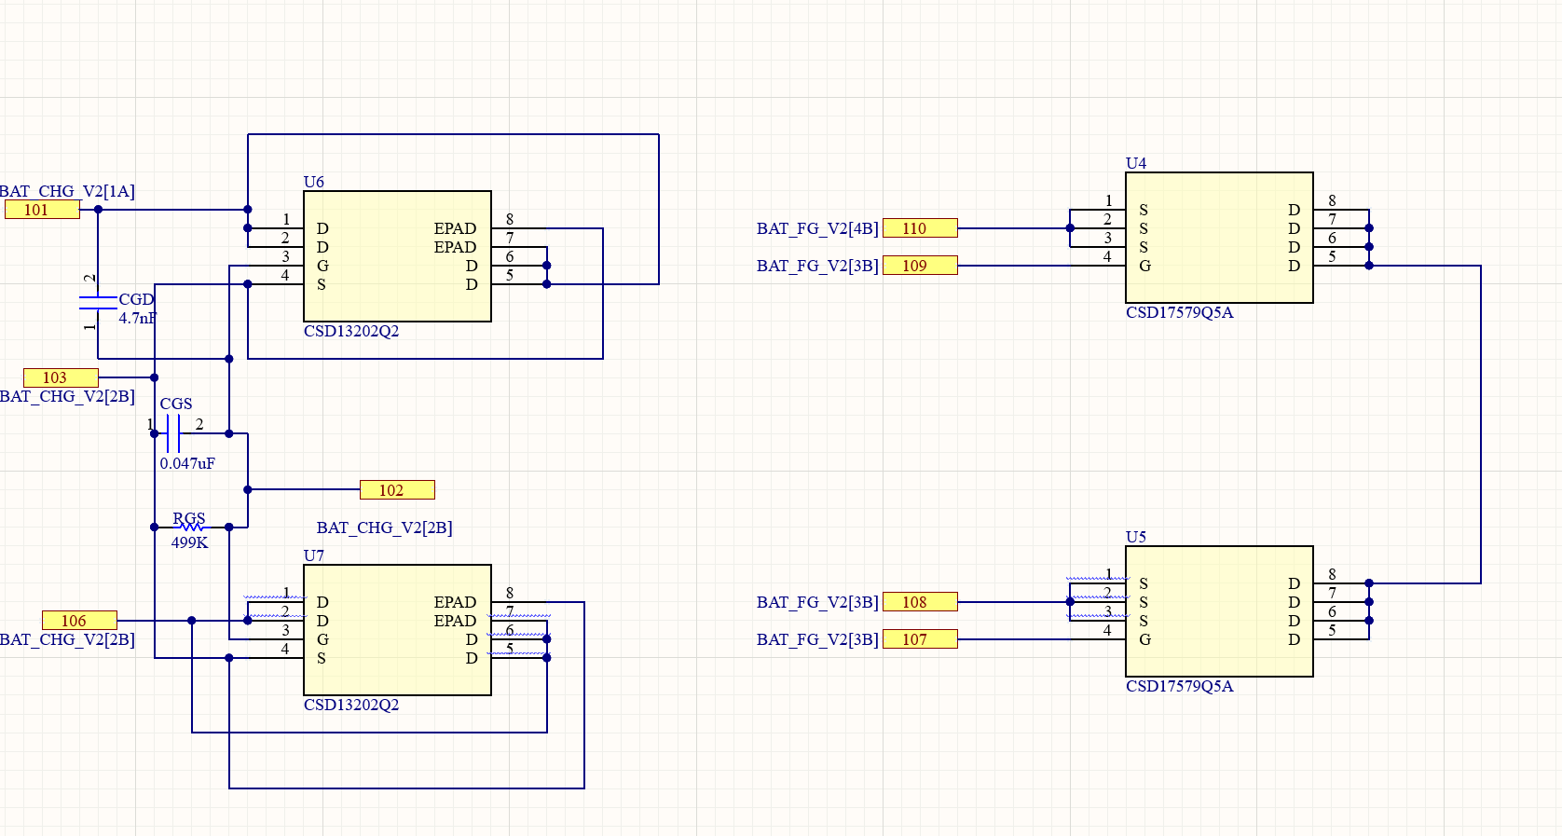
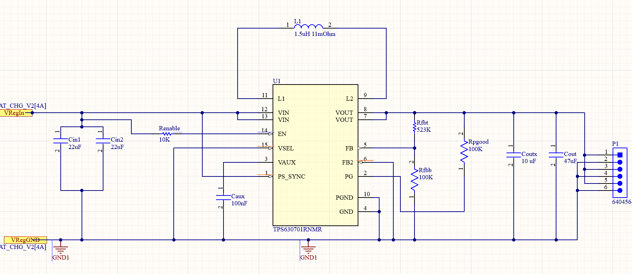
Power Subsystem
Michael McNeil

Slide 8
ML / Control Subsystem
Andrew Albritton
Accomplishments since 403 10 hrs of effort | On going progress/problems and plans until the next presentation
Met with sponsor to figure out needed additions to subsystem Soldered Arduino Acquired relay from parts room | Write code for Arduino relay control Gather better validation supplies / use supplies to test edge cases on minimum/maximum distance for classification

Slide 9
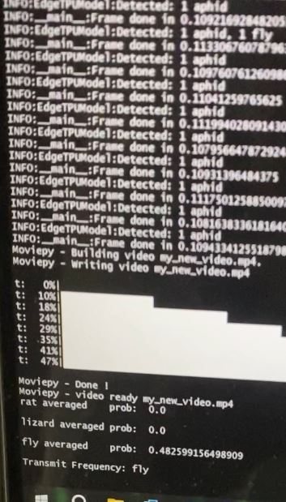
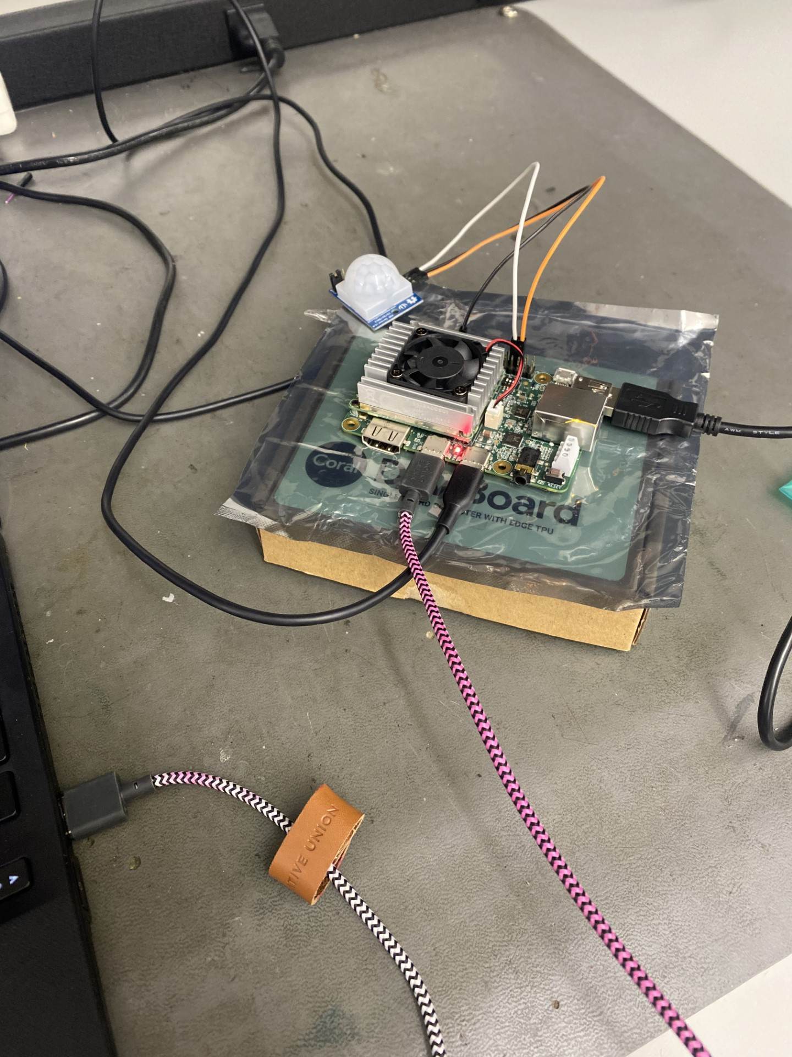
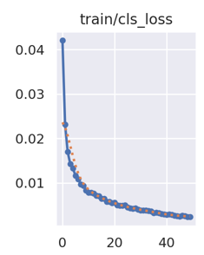
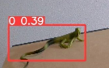
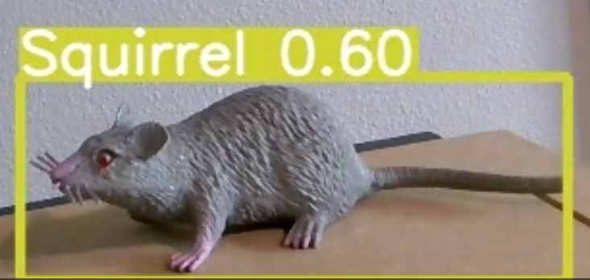
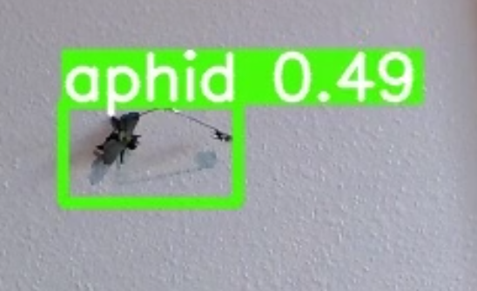
ML / Control Subsystem
Andrew Albritton

Slide 10
Emitter Subsystem
Melquisedec Ordonez
Accomplishments since 403 8 hrs of effort | Ongoing progress/problems and plans until the next presentation
Subsystem works as it did during demo.(not up to MVP) | Redesign of pcb underway( designing own amplifier to accommodate ultrasonic emitters/reduce signal noise) Transition emitter control from arduino to system MCU(coral board) Add basic system information update to screen

Slide 11
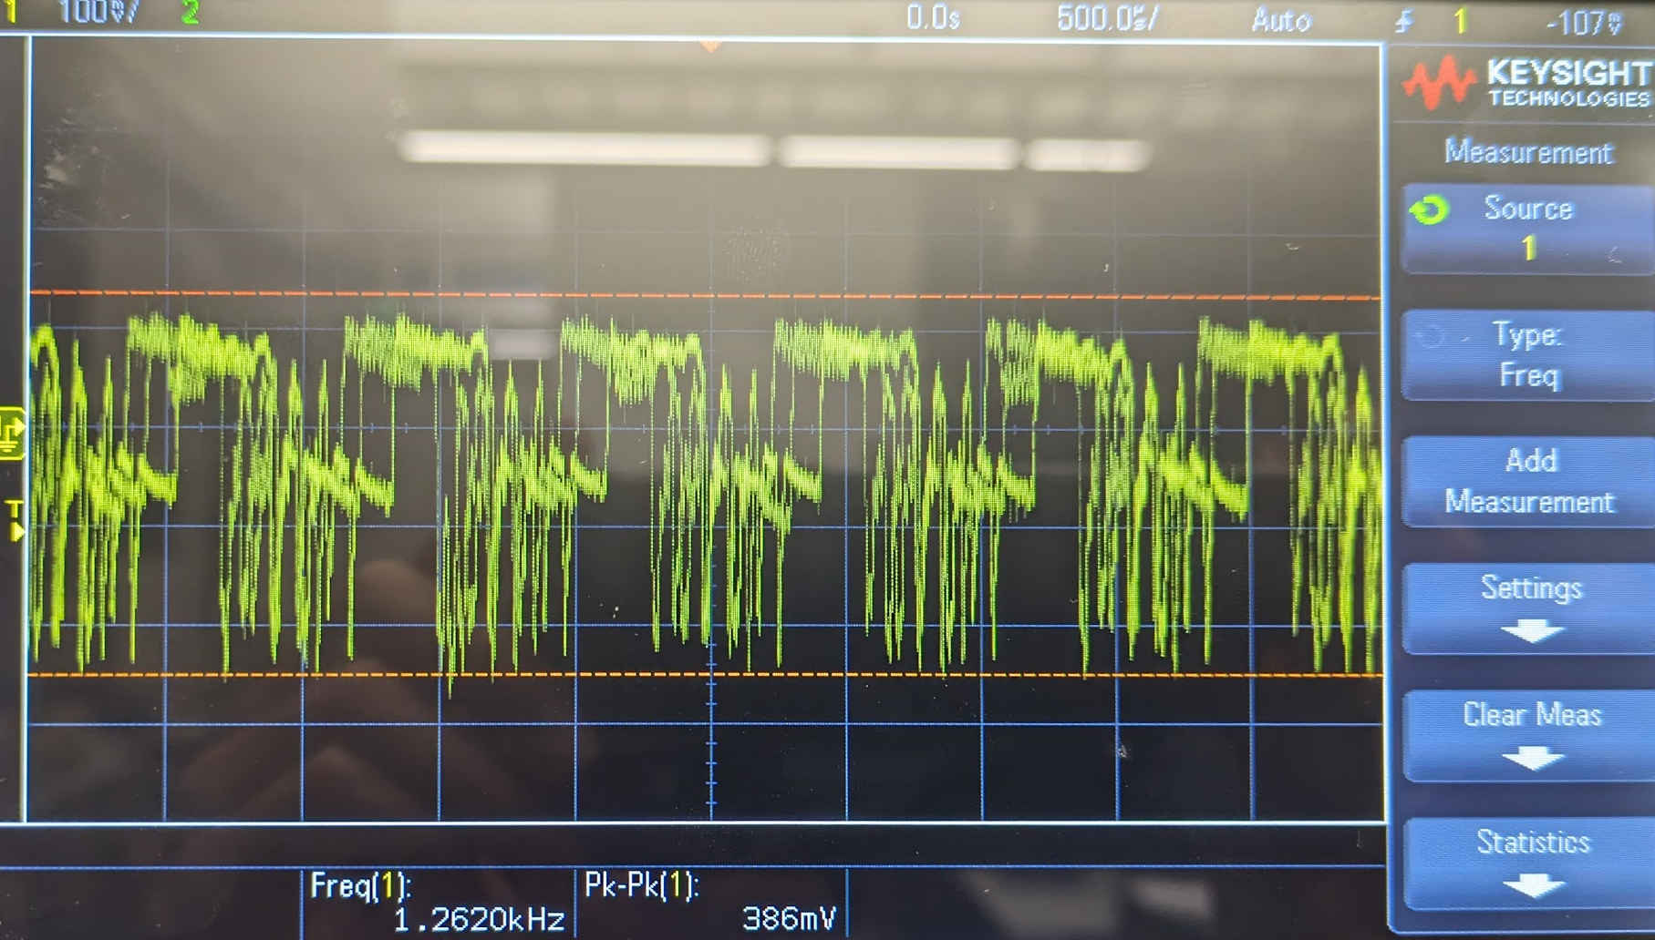
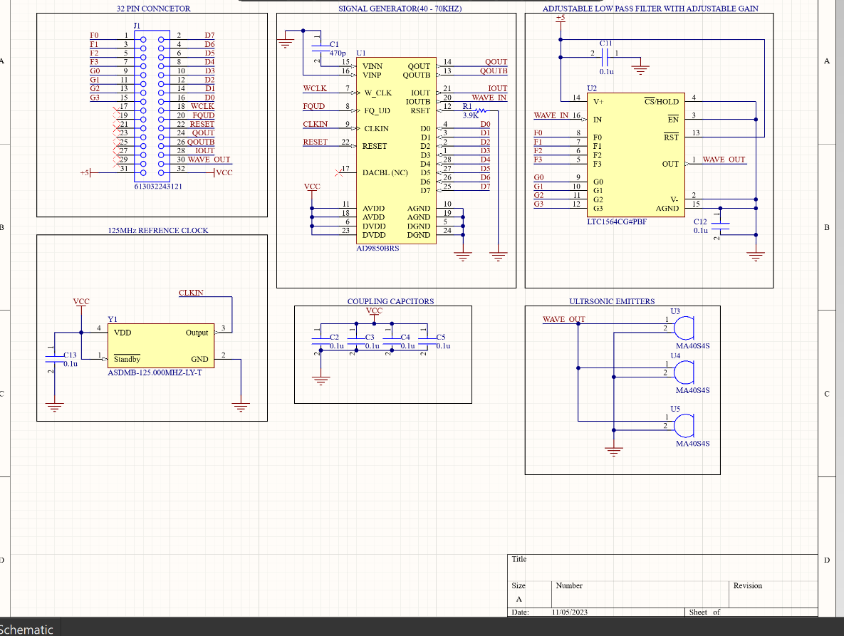
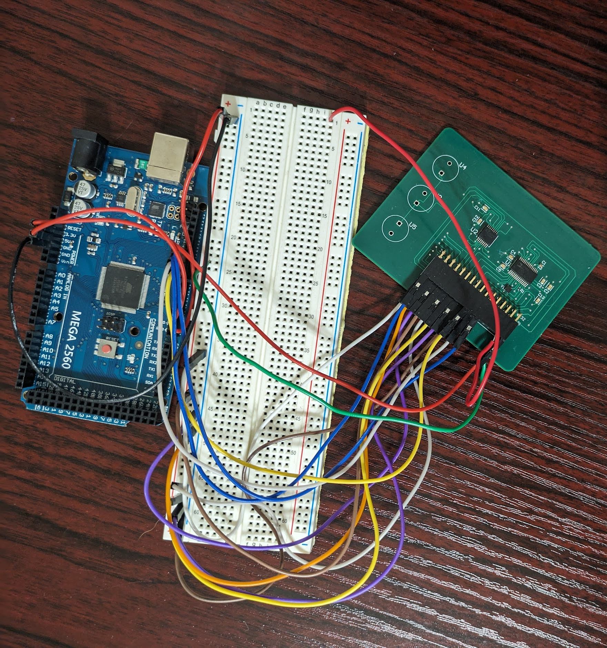
Emitter Subsystem
Melquisedec Ordonez

Slide 12
Parts Ordering Status
Parts for the Power System PCB redesign have already been ordered and should arrive sometime this week. The PCB will be ordered as soon as it is done in the coming weeks.
Larger passive components for emitter PCB will be ordered this week with new components and PCB ordered once redesign is complete no later than 2/19..
Notes:
Michelle

Slide 13
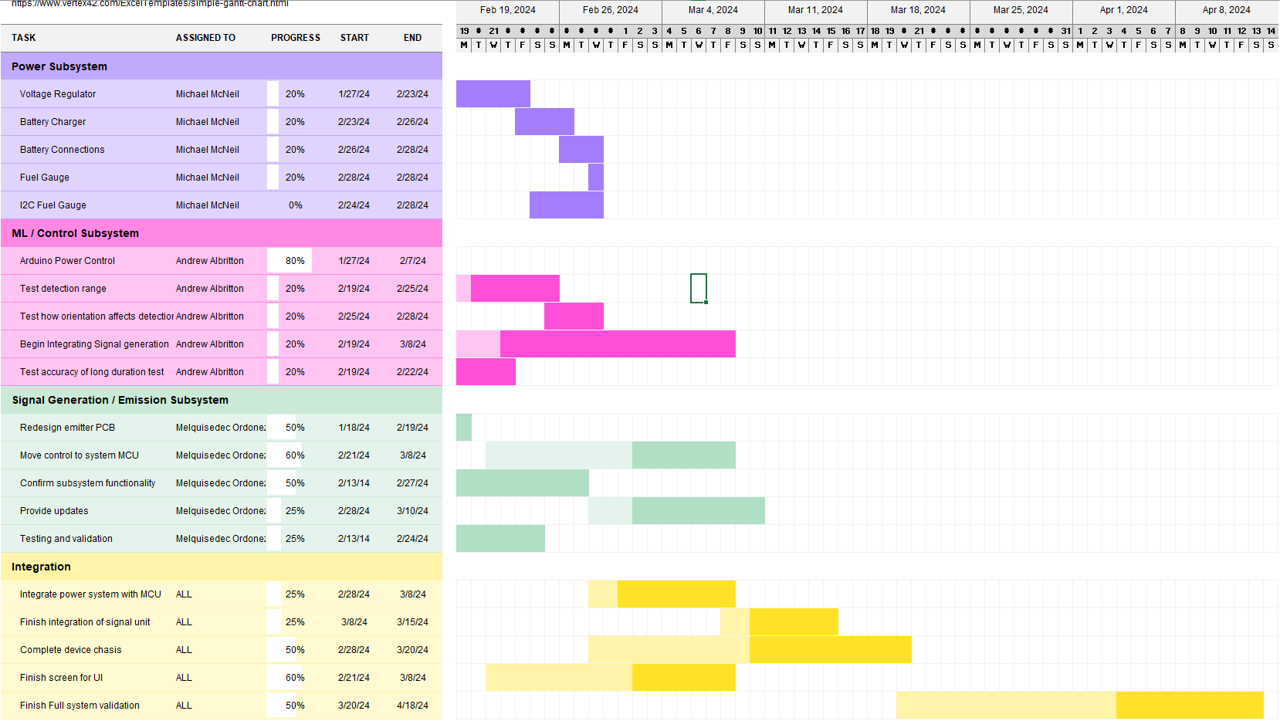
Execution & Plan
Notes:
Michelle

Slide 14
Thank You

